Slide 1


Depi Testers
"Transform your software into a flawless experience with our top-tier testing services—where quality meets excellence!"

Slide 2







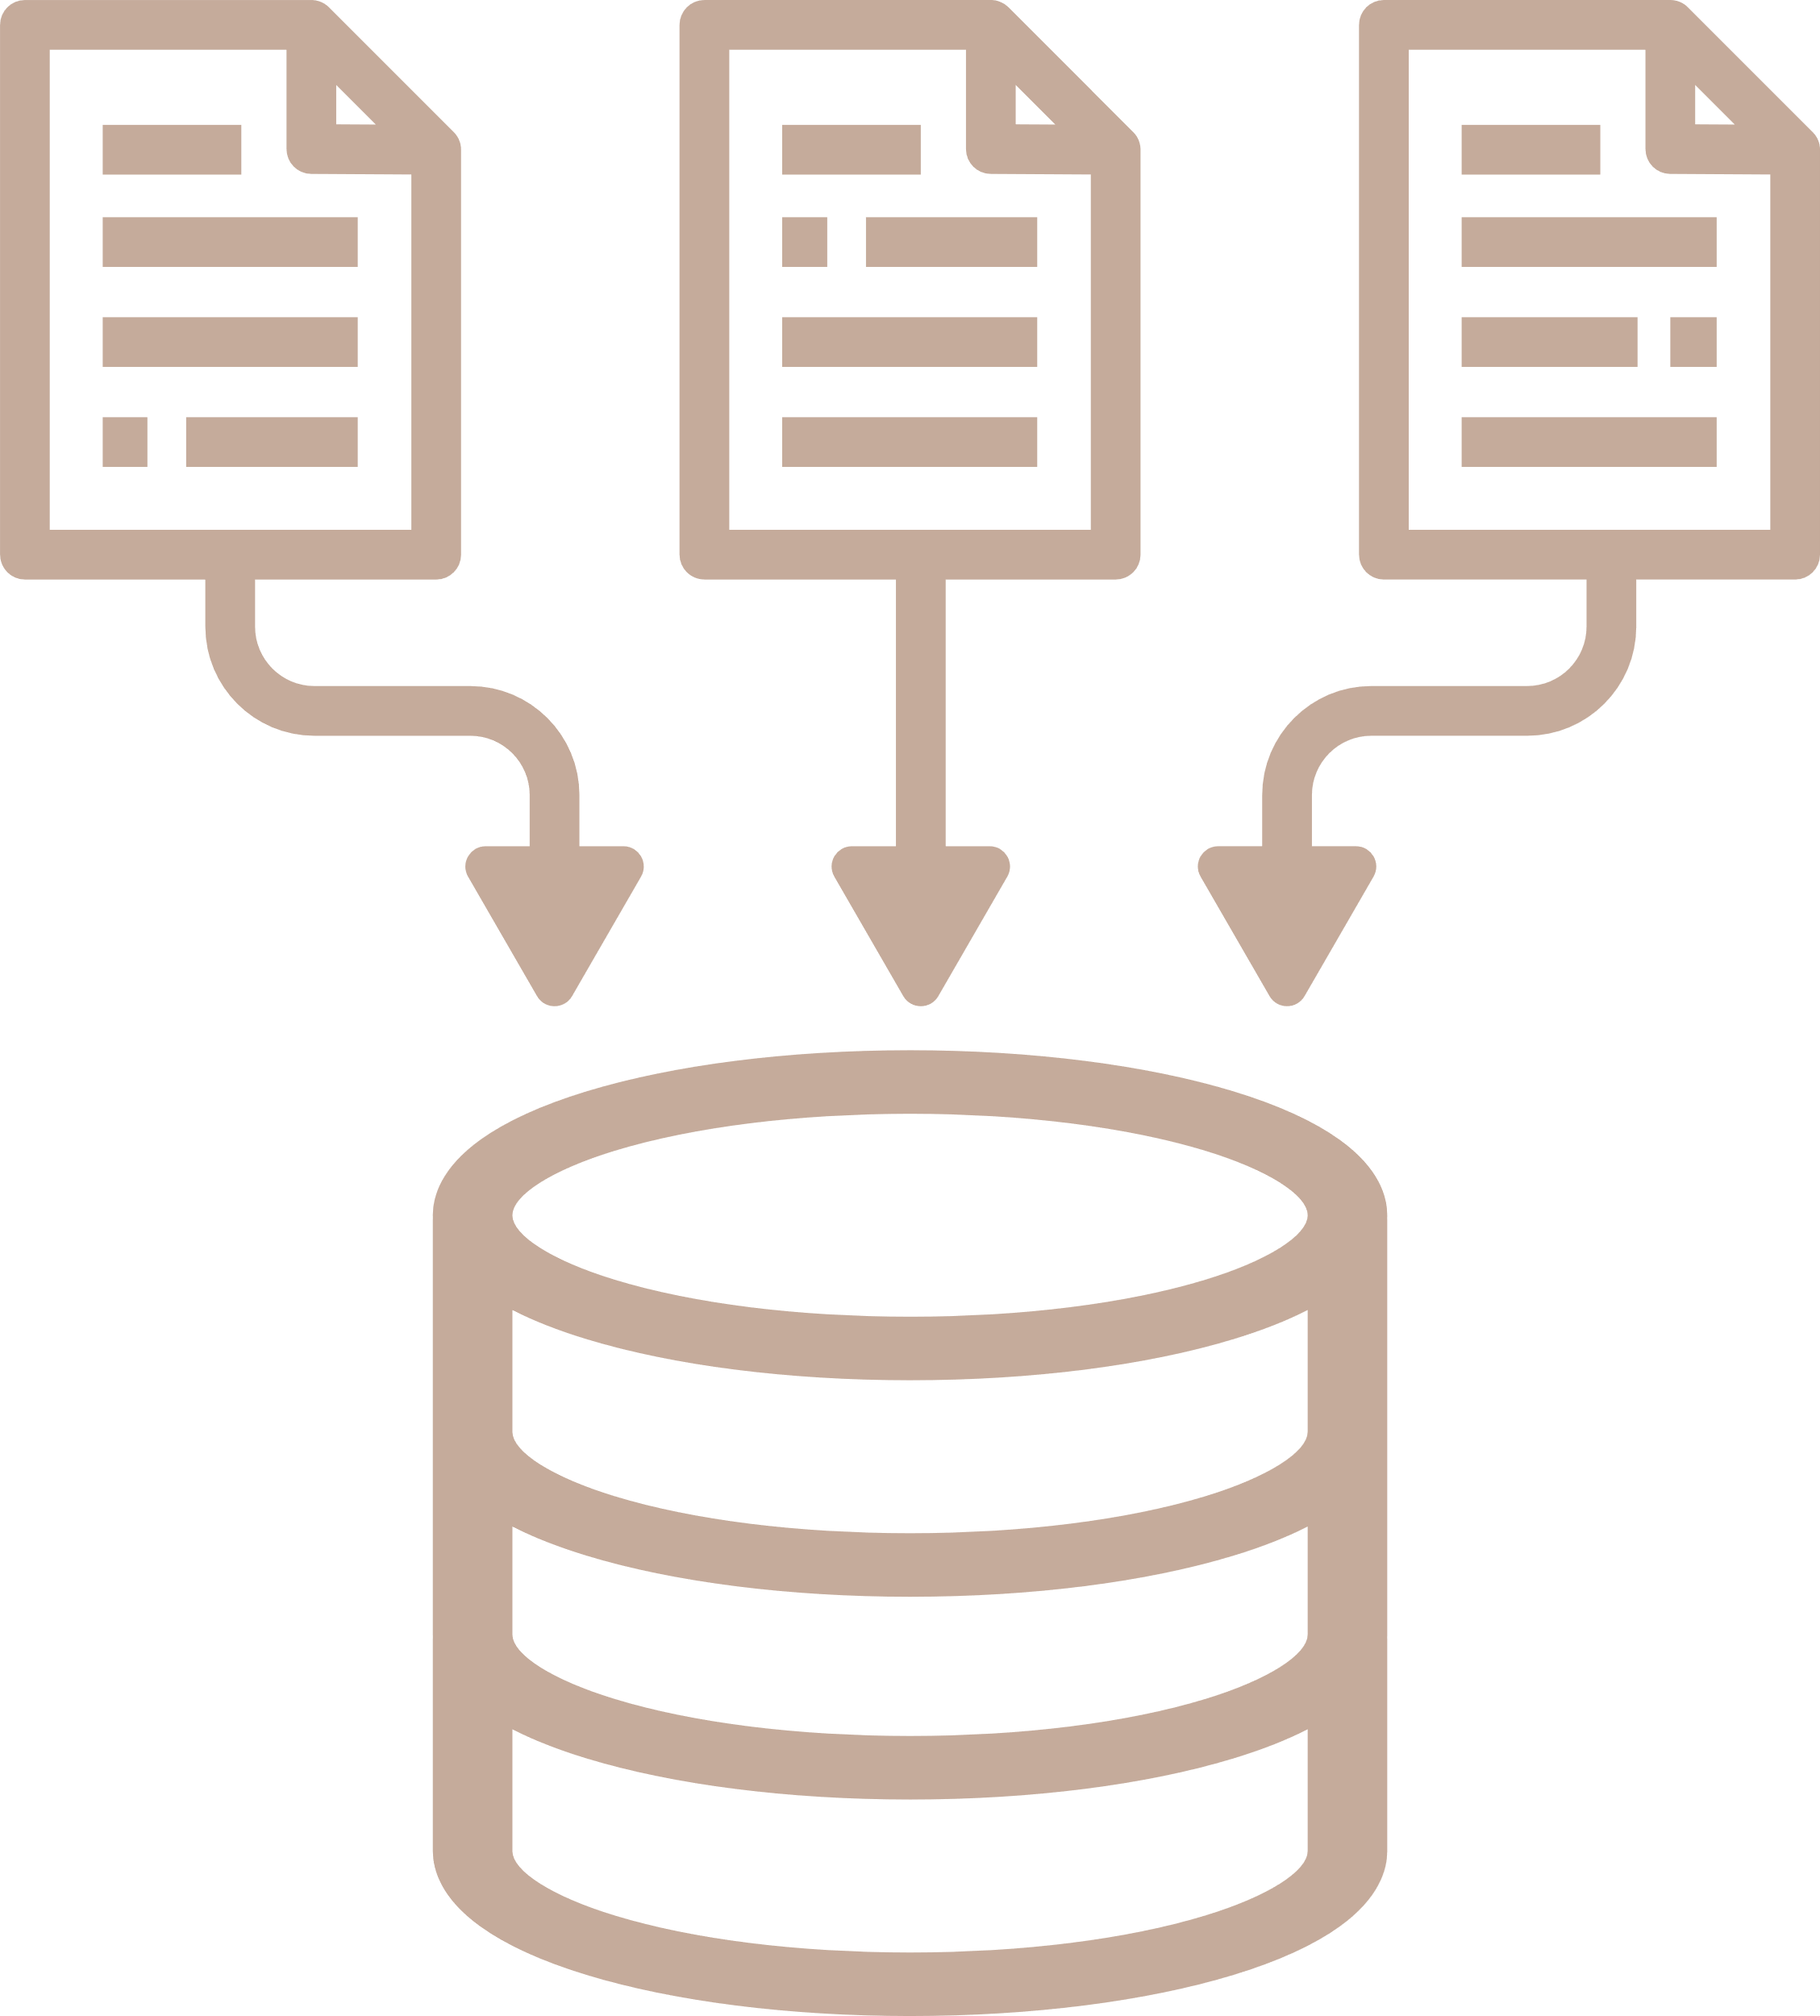
The Challenges Businesses Face Today
Trust and Security
User Experience
Performance Monitoring
Feature Integration
Building user trust in online transactions, especially for second-hand goods.
Ensuring a user-friendly and intuitive platform for better engagement.
Maintaining high performance and quick load times during peak usage.
Seamlessly integrating various features (e.g., messaging, payments) without issues.
Mobile Compatibility
Bug Detection
Data Management
Market Competition
Ensuring the platform is responsive and functional on mobile devices
Quickly identifying and resolving bugs to maintain reliability.
Handling user data responsibly while ensuring privacy compliance.
Differentiating from established competitors in a crowded marketplace

Slide 3


Introduction
(Second-Hand Goods Platform) for a seamless buying and selling experience
Objective: Ensure reliability, security, and usability through comprehensive testing and bug identification.
Key Focus Areas: User registration, product listing, and secure messaging.
Scope of Testing:
- Manual testing using Google Sheets.
- Automated testing with java Selenium and testng
Outcome: Deliver a high-quality platform that users can trust and easily navigate

Slide 4

What Sets Us Apart?
Comprehensive testing approach: We use manual and automated testing to ensure comprehensive feature validation, and improve the overall quality of the platform
User-centric: Our testing prioritizes user experience, ensuring the platform is intuitive, secure, and responsive across devices.
Agile Feedback Loop: Rapid identification and reporting of issues allow for quick iterations and improvements, ensuring timely enhancements based on user feedback.
Comprehensive testing approach: We use manual and automated testing to ensure comprehensive feature validation, and improve the overall quality of the platform.
Performance Monitoring: Continuous assessment of performance metrics ensures the platform remains efficient and reliable under varying loads.

Slide 5
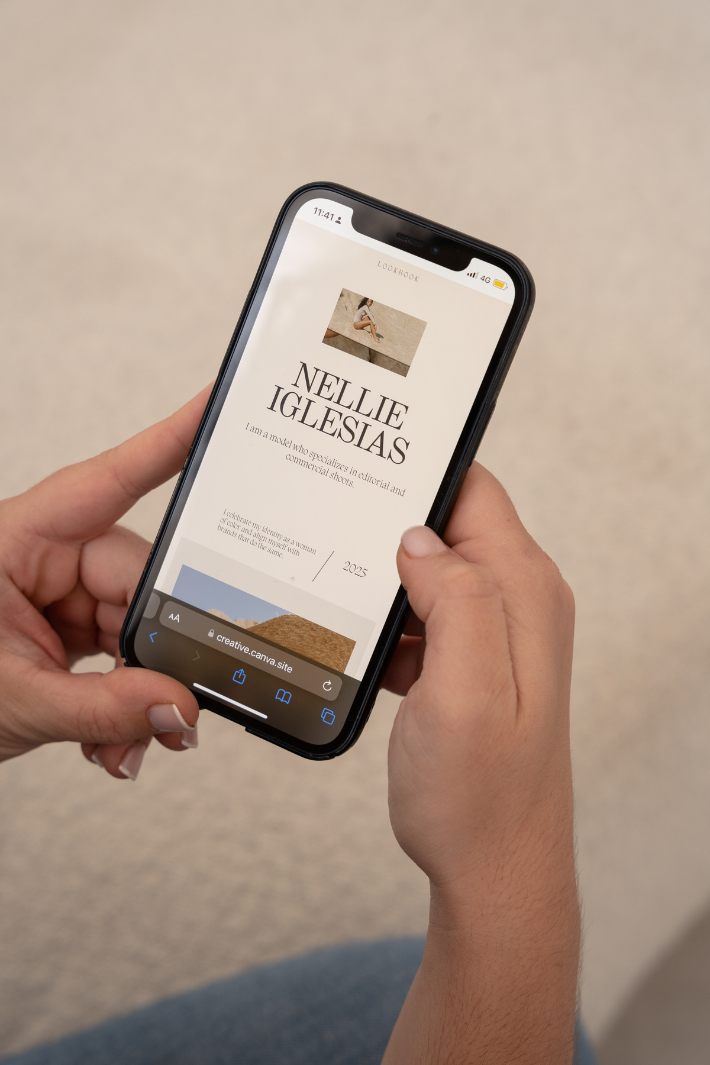

Why Choose Us?
Expertise in Diverse Testing
Our team excels in both manual and automated testing, ensuring comprehensive coverage of all functionalities.
User-Centric Approach
We prioritize the end-user experience, conducting thorough usability testing to enhance satisfaction.
Agile and Adaptable
We respond quickly to changes and feedback, ensuring that our testing aligns with project timelines and objectives.
Commitment to Quality
We are dedicated to delivering a high-quality platform by ensuring all features are validated and functional before launch.

Slide 6






Who Can Benefit?
Business Owner
Developers
Sellers
Freelancers
Customer Support Teams

Slide 7


Ready to Transform Your Business?
Start Your Journey: Sign up now and receive a 15% discount on your first testing project to see how our services can enhance the quality and reliability of your software.
Explore More: Visit our website at Depi_testers@gmail.com for additional information on our services.
Get in Touch: Have questions? Contact us directly!
- Email: info@depitesters.com
- Phone: 310-987-6543

Slide 8





Affordable Pricing Plans to Suit Every Business
Enterprise Plan
Professional Plan
For Large Organizations with Advanced Needs.
Features:
All Professional Plan features
Tailored solutions for specific requirements
Dedicated account management
API access and advanced integrations
Pricing: Custom pricing based on needs
Free Consultation: Personalized assessment to determine needs
Basic Plan
For Growing Businesses.
Features:
All Basic Plan features
Advanced analytics and reporting
Priority customer support
Enhanced search filters
Pricing: Competitive monthly fee
Ideal for Small Teams.
Features:
Essential features for listings and messaging
Basic reporting tools
User support via email
Pricing: Affordable monthly fee

Slide 9




Let's Work Together
+123-456-7890
info@depitesters.com

